Slide 1
Algorithms Connected Components
CSE 464/574
Spring 2019

Slide 2
Connected Components
Definition: Vertices v and w are connected if there is a path between them.
Goal. Preprocess graph to answer queries of the form is v connected to w? in constant time.
public class CC {
CC(Graph G) // find connected components in G
boolean connected(int v, int w) // are v and w connected?
int count() // number of connected components
int id(int v) // component identifier for v
(between 0 and count() - 1)

Slide 3
Connected components
The relation "is connected to" is an equivalence relation:
Reflexive: v is connected to v.
Symmetric: if v is connected to w, then w is connected to v.
Transitive: if v connected to w and w connected to x, then v connected to x.
Definition: A connected component is a maximal set of connected vertices.

Slide 4
Connected components
Goal. Partition vertices into connected components.
Connected components
Initialize all vertices v as unmarked.
For each unmarked vertex v, run DFS to identify all vertices discovered as part of the same component.

Slide 5
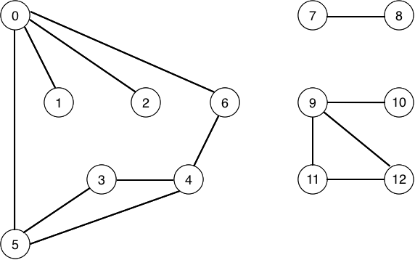
Connected components
v | marked[] | id[]
 | F | –
1 | F | –
2 | F | –
3 | F | –
4 | F | –
5 | F | –
6 | F | –
7 | F | –
8 | F | –
9 | F | –
10 | F | –
11 | F | –
12 | F | –
To visit a vertex v :
Mark vertex v as visited.
Recursively visit all unmarked vertices adjacent to v.

Slide 6
v | marked[] | id[]
 | F | 0
1 | F | 0
2 | F | 0
3 | F | 0
4 | F | 0
5 | F | 0
6 | F | 0
7 | F | 1
8 | F | 1
9 | F | 2
10 | F | 2
11 | F | 2
12 | F | 2

Slide 7
Finding connected components with DFS
public class CC
{
private boolean[] marked;
private int[] id;
private int count;
public CC(Graph G)
{
marked = new boolean[G.V()];
id = new int[G.V()];
for (int v = 0; v < G.V(); v++)
{
if (!marked[v])
{
dfs(G, v);
count++;
}
}
}

Slide 8
Finding connected components with DFS (continued)
public int count()
{
return count;
}
public int id(int v)
{
return id[v];
}
public boolean connected(int v, int w)
{
return id[v] == id[w];
}
private void dfs(Graph G, int v)
{
marked[v] = true;
id[v] = count;
for (int w : G.adj(v))
if (!marked[w])
dfs(G, w);
}

Slide 9
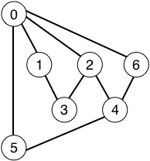
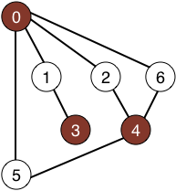
Graph-processing challenges
Problem. Is a graph bipartite?
How difficult?
Any programmer could do it.
✓ Typical diligent algorithms student could do it.
simple DFS-based solution
Hire an expert.
Intractable.
No one knows.
Impossible.

Slide 10
Graph-processing challenges
Problem. Find a cycle.
How difficult?
Any programmer could do it.
✓ Typical diligent algorithms student could do it.
simple DFS-based solution
Hire an expert.
Intractable.
No one knows.
Impossible.
Cycle: 0-5-4-6-0

Slide 11
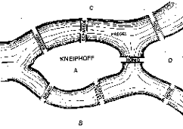
Bridges of Königsberg
The Seven Bridges of Königsberg. [Leonhard Euler 1736]
“ … in Königsberg in Prussia, there is an island A, called the Kneiphof; the river which surrounds it is divided into two branches ... and these branches are crossed by seven bridges. Concerning these bridges, it was asked whether anyone could arrange a route in such a way that he could cross each bridge once and only once. ”
Euler cycle. Is there a (general) cycle that uses each edge exactly once?
Answer. A connected graph is Eulerian iff all vertices have even degree.

Slide 12

Graph-processing challenge 3
Problem. Find a (general) cycle that uses every edge exactly once.
How difficult?
Any programmer could do it.
✓ Typical diligent algorithms student could do it.
Euler cycle
Hire an expert.
Intractable.
No one knows.
Impossible.
0-1-2-3-4-2-0-6-4-5-0

Slide 13

Graph-processing challenge 4
Problem. Find a cycle that visits every vertex exactly once.
How difficult?
Any programmer could do it.
Typical diligent algorithms student could do it.
Hire an expert.
✓ Intractable.
Hamilton cycle (classical NP-complete problem)
No one knows.
Impossible.
0-5-3-4-6-2-1-0

Slide 14

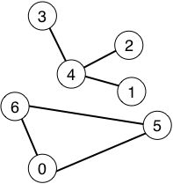
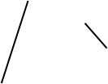
Graph-processing challenge 5
Problem. Are two graphs identical except for vertex names?
How difficult?
Any programmer could do it.
Typical diligent algorithms student could do it.
Hire an expert.
Intractable.
✓ No one knows.
graph isomorphism is longstanding open problem
Impossible.
0↔4, 1↔3, 2↔2, 3↔6, 4↔5, 5↔0, 6↔1

Slide 15
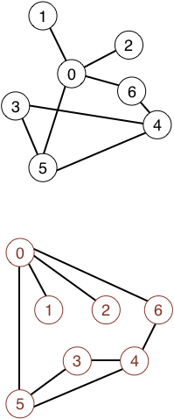
Graph-processing challenge 6
Problem. Lay out a graph in the plane without crossing edges?
How difficult?
Any programmer could do it.
Typical diligent algorithms student could do it.
✓ Hire an expert.
linear-time DFS-based planarity algorithm discovered by Tarjan in 1970s
Intractable.
No one knows.
Impossible.

Slide 16
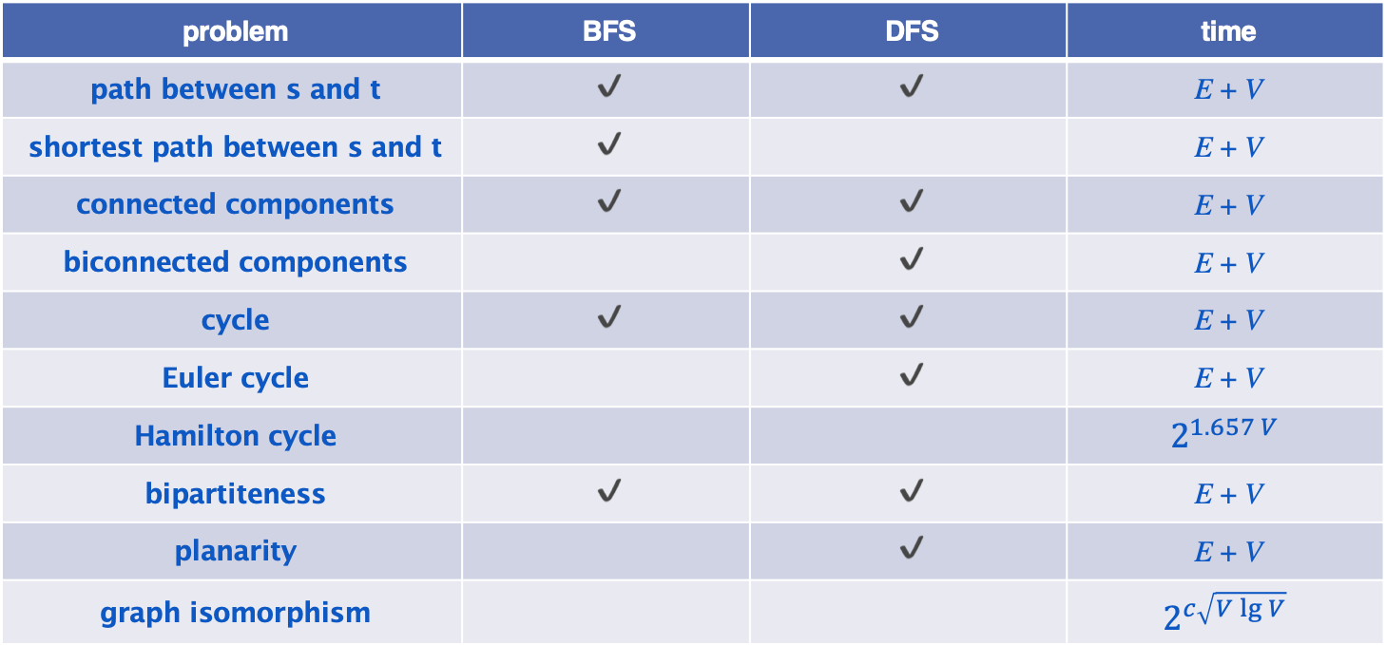
Graph traversal summary
problem | BFS | DFS | time
path between s and t | ✔ | ✔ | E + V
shortest path between s and t | ✔ |  | E + V
connected components | ✔ | ✔ | E + V
biconnected components |  | ✔ | E + V
cycle | ✔ | ✔ | E + V
Euler cycle |  | ✔ | E + V
Hamilton cycle |  |  | $$2^{1.657 V}$$
bipartiteness | ✔ | ✔ | E + V
planarity |  | ✔ | E + V
graph isomorphism |  |  | $$2^{c\sqrt{V\lg{V}}}$$

